Slide 1
Why Sketching with Hardware?
Albrecht Schmidt LMU München, 2020

Slide 2
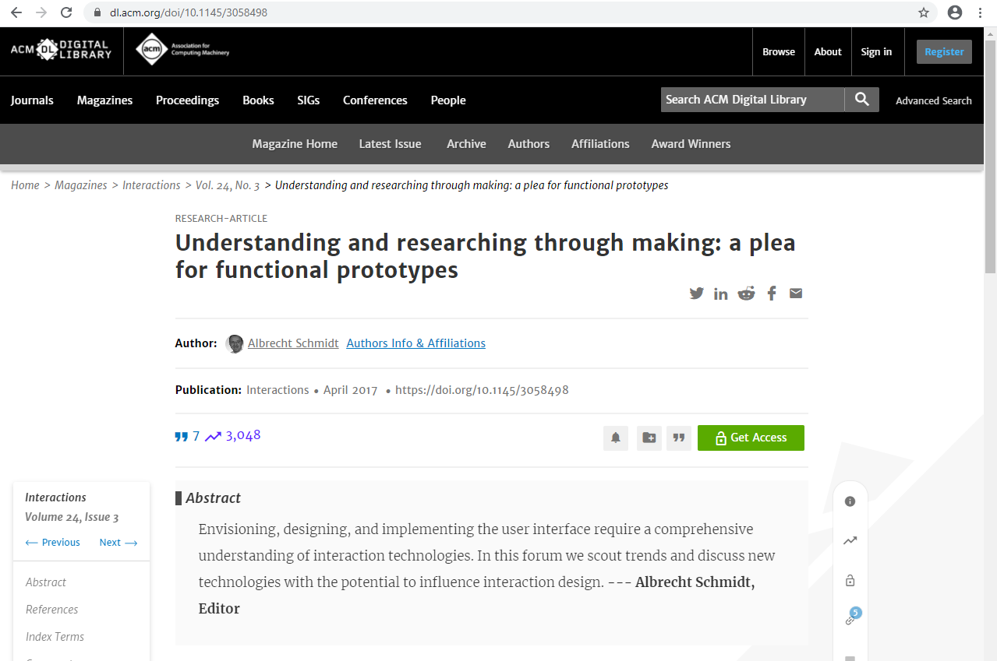
Albrecht Schmidt. 2017. Understanding and researching through making: a plea for functional prototypes. interactions 24, 3 (May + June 2017), 78–81. DOI:https://doi.org/10.1145/3058498

Slide 3
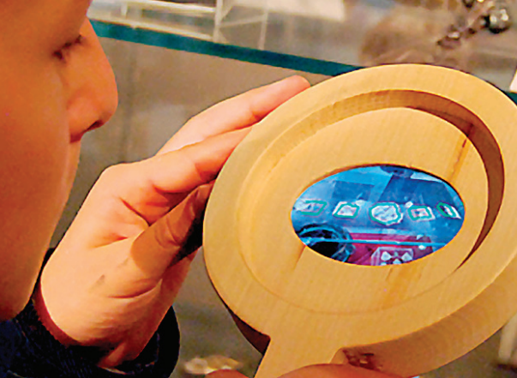
HOW TO CREATE FUNCTIONAL PROTOTYPES
Repackaged off-the-shelf devices
Systems
of standard hardware components
add-ons to common hardware components
Custom hardware development

Slide 4
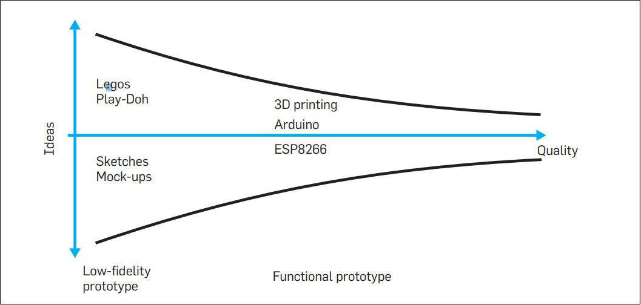

Slide 5
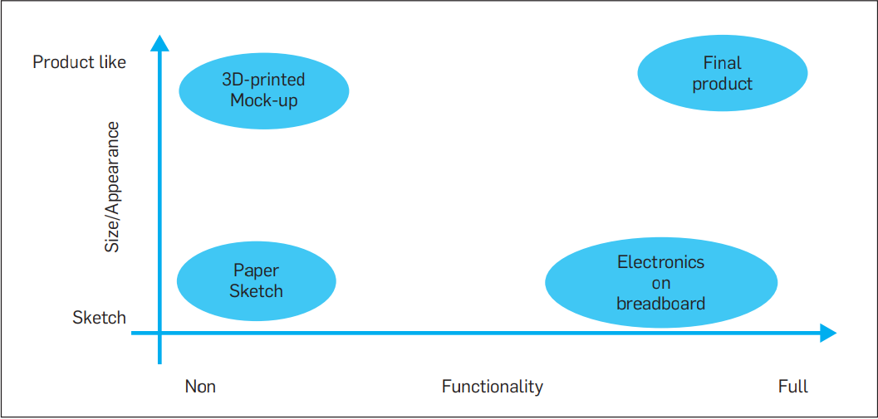

Slide 6
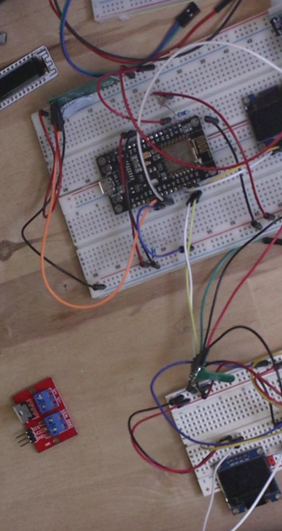
HOW TO CREATE FUNCTIONAL PROTOTYPES
Repackaged off-the-shelf devices
Systems
of standard hardware components
add-ons to common hardware components
Custom hardware development

Slide 7
Learning Goals
Being able to transform an idea for an interactive smart object or device into a functional prototype, that can be realistically experienced.

Slide 8
What are the functional prototypes good for?
Communicating the idea in detail
Allowing someone to experience the idea
Understanding challenges in usage
Conducting realistic studies
Providing a rough blue print to get it implemented

Slide 9
References
Albrecht Schmidt. 2017. Understanding and researching through making: a plea for functional prototypes. interactions 24, 3 (May + June 2017), 78–81. DOI:https://doi.org/10.1145/3058498

